Slide 1
Zendesk Plan for Company B
Jonathan Scott

Slide 2
Objectives
Agent Efficiency
Case Reduction
Customer Experience

Slide 3
Zendesk Guide
Refers to the Zendesk product that is the Support Site hosted on Zendesk
Goals:
Bring email case submission down and increase traffic to the Support Site where customers can self serve.
Have Support be able to create and reference customer facing articles to educate customers how to get answers without creating cases.
Enable Agents to create direct links to information within cases to create consistent answers
Populate the Support Site with content to answer potential questions before cases are created

Slide 4
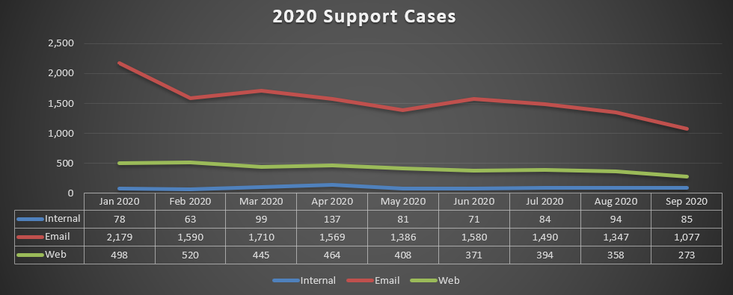
Existing Support Site: Case Creation
Tier 1
13,180 cases
18.6 hrs Avg Resolution (Business hours) excluding JIRA linked
Just over 2 business days
Tier 2
5,757 cases
28.3 hrs Avg Resolution (Business hours) excluding JIRA linked
About 3 ½ business days
An average of 75% of cases submitted came from email.
20% comes from the website.
This means at least 20% of the time; users are already looking at the Support Site and can not find a solution.
“Internal” refers to cases created by an internal team (Sales, CSM, Support, etc).

Slide 5
Existing Support Site
Search does not return helpful results
Updates need to go through a different department, which may be a low priority for them
No ZD Portal Access for Payers, to view and comment on Open/Closed cases

Slide 6
Proposed Support Site: Header
Push Payers to register for a Support portal:
Allows for immediate association of a case with Payer
‘My Activites’ - shows all cases (open or closed) for User and/or Org based on access control
Custom alerts (top of the page) can be added that will deflect ticket creation for known global issues and notifications of holidays.

Slide 7
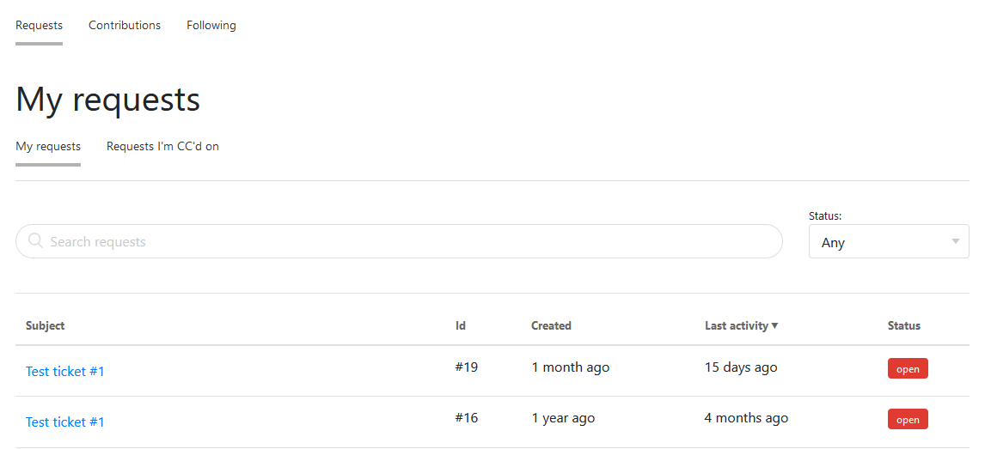
Proposed Support Portal: My Activities

Slide 8
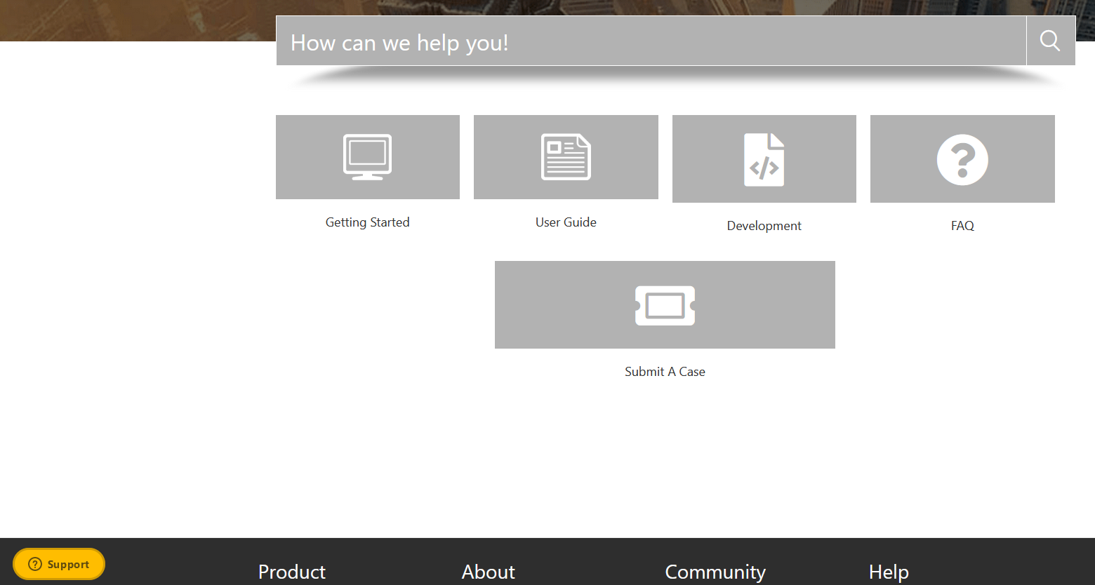
Proposed Support Site: Main
Test Account
URL: https://jonathanscottj.zendesk.com/hc/en-us
Login: enduser@jonathanscottj.com
Password:
****
Note: Support can Self Service this Page + Maintain it in conjunction w/ Product Teams.

Slide 9
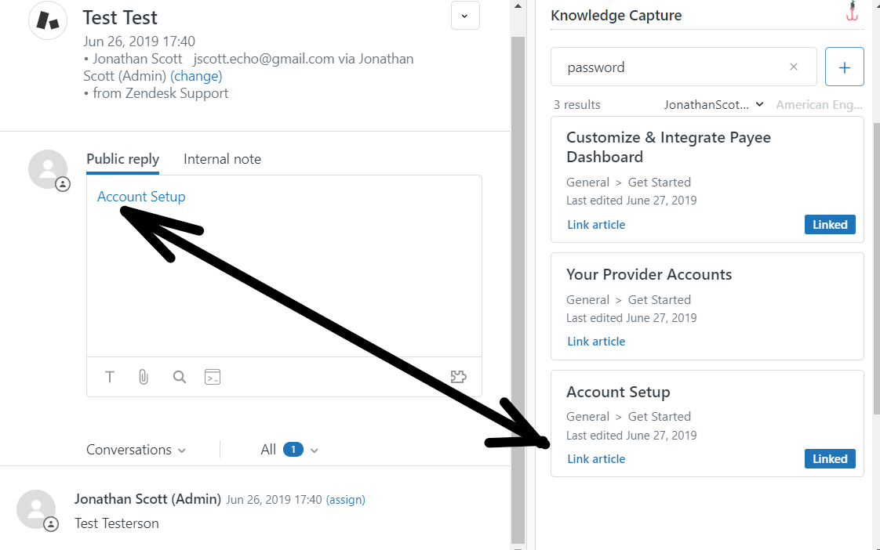
Zendesk Knowledge Capture - Agent
An agent are provided ZD KB results based on the subject line and content of the case.
Also, Manual search capability will also exist for extracting KB Results.

Slide 10
Gathering specific data at Case creation
Goals:
Knowing who the case requester is and what account they are associated with when case is submitted.
Create specific fields for requesters to fill out at case creation.
This will reduce the amount of time taken to resolve cases and reduce the number of contacts needed

Slide 11
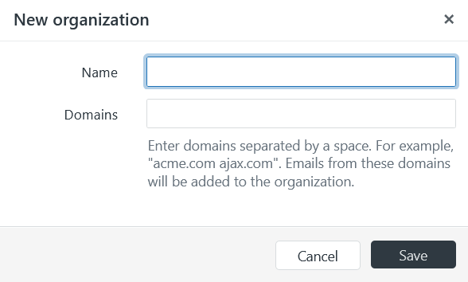
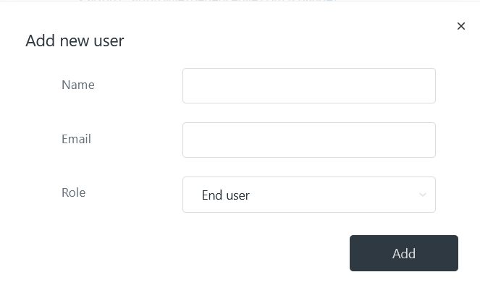
Proactive Organization/User Creation
Payers are asked for Support contacts and email domains of users during implementation.
End-users and Organizations are created before any issues are reported.

Slide 12
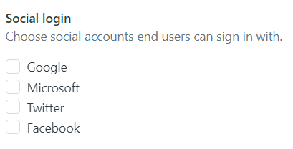
Zendesk Guide- Routes to Support
OR
SSO Login via JSON token

Slide 13
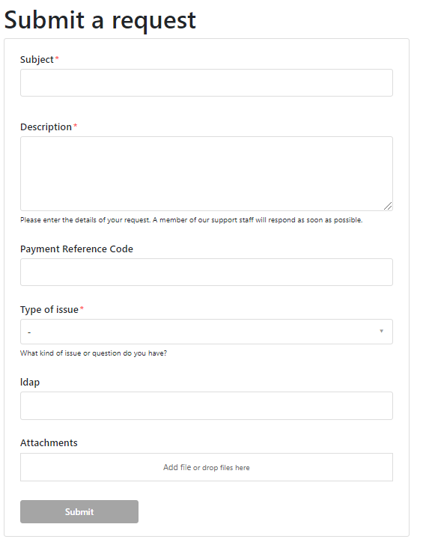
Case fields
Via website case creation and Zendesk Widget
Allows for customized fields to be filled out by the end user at case creation

Slide 14
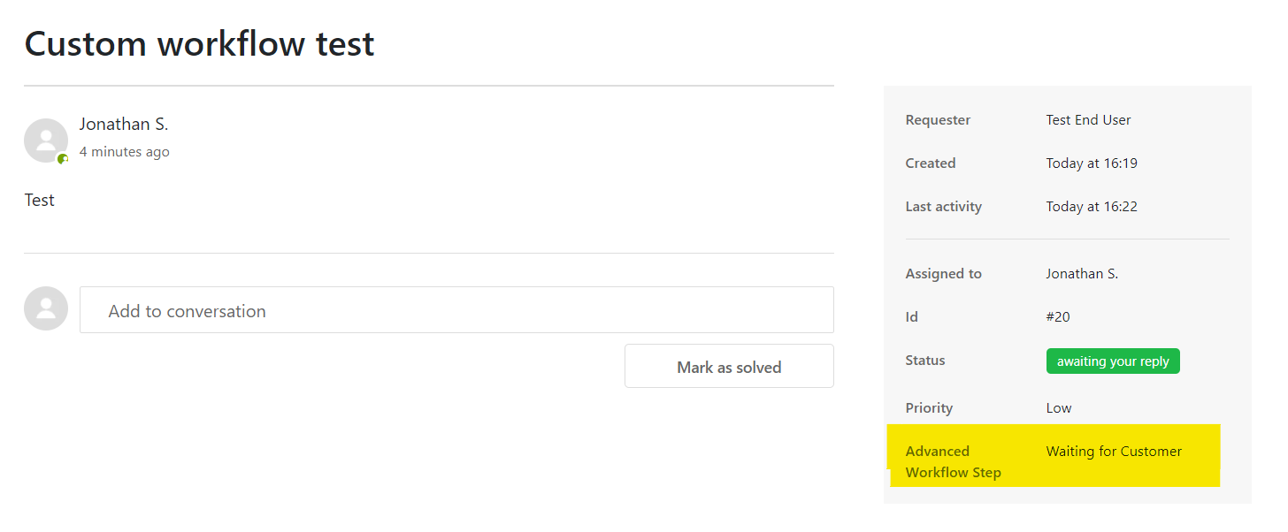
Custom Zendesk Statuses
Allows for custom customer facing statuses that give end users more specific information on the status of their case (being looked at by Product, pending solve at next release, etc)

Slide 15
Integrations
Goals:
Facilitate the flow of data between Zendesk and other tools used by the Operations and Engineering teams to minimize the time needed to gather the data and provide quicker responses and resolutions to end users

Slide 16
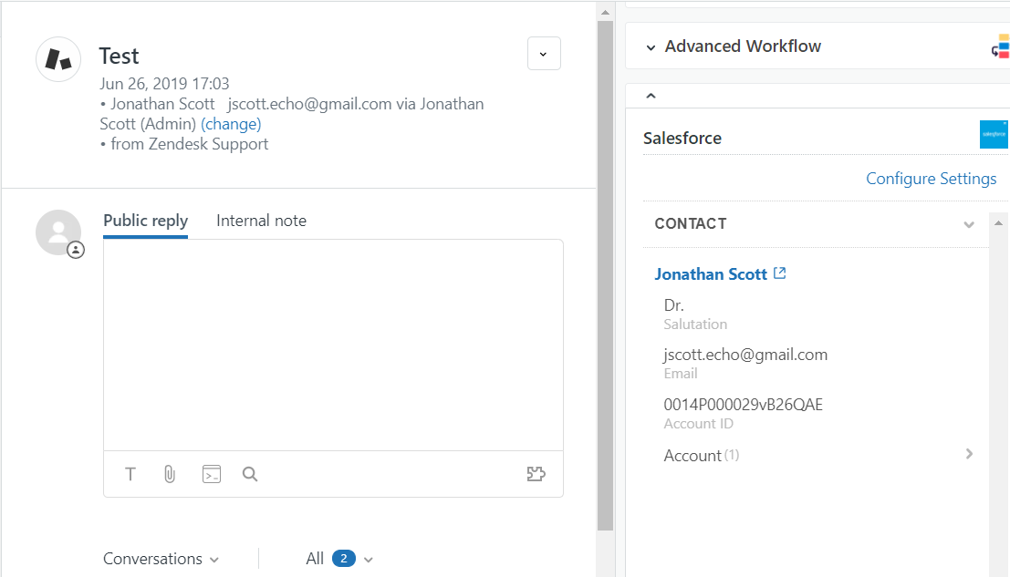
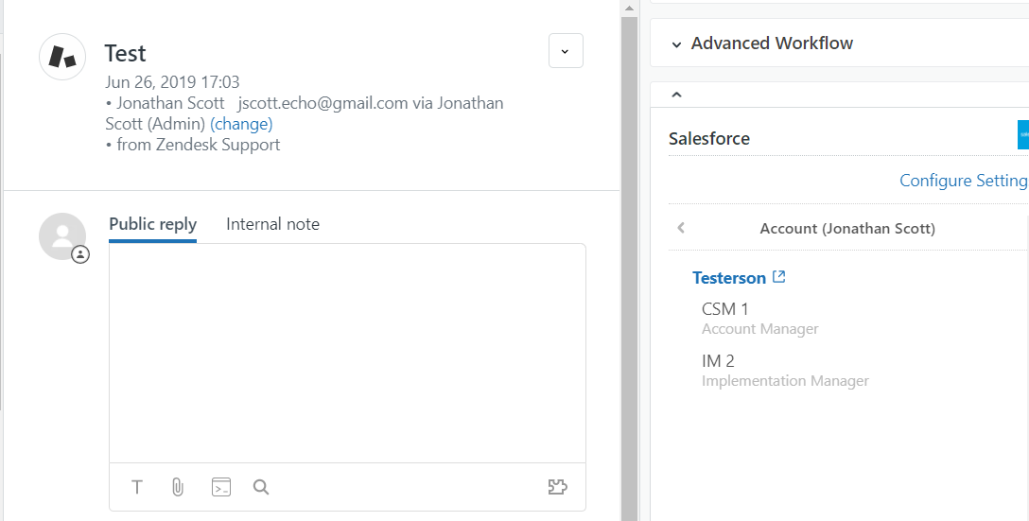
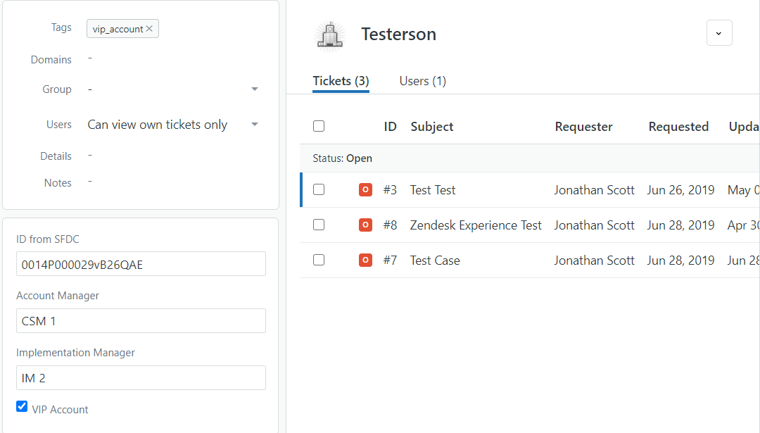
SalesForce > Zendesk Integration
Be able to pull account specific data directly from SalesForce into Zendesk.
Contact name
CSM Name
IM Name
VIP Account identifier
Projected Revenue
Note: Sales Operations will only allow read-only access to SalesForce

Slide 17
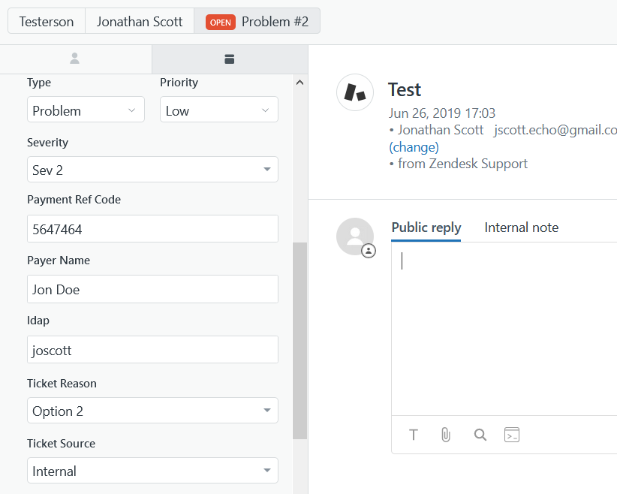
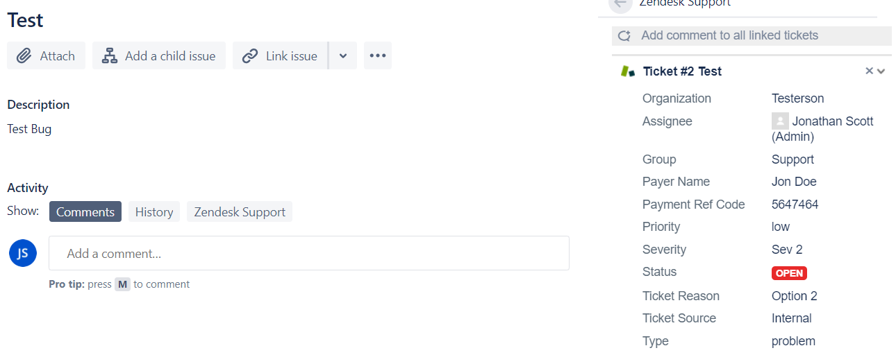
Zendesk > JIRA Integration (Case Fields)
Allows for data to flow directly from the Zendesk case into JIRA where it is available for any Engineer to view
Engineering has stated that they want as much data as possible due to the time difference

Slide 18
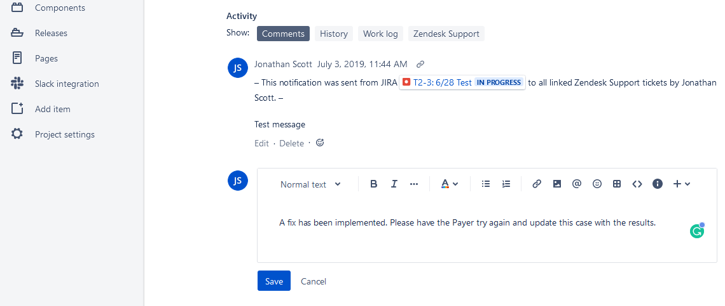
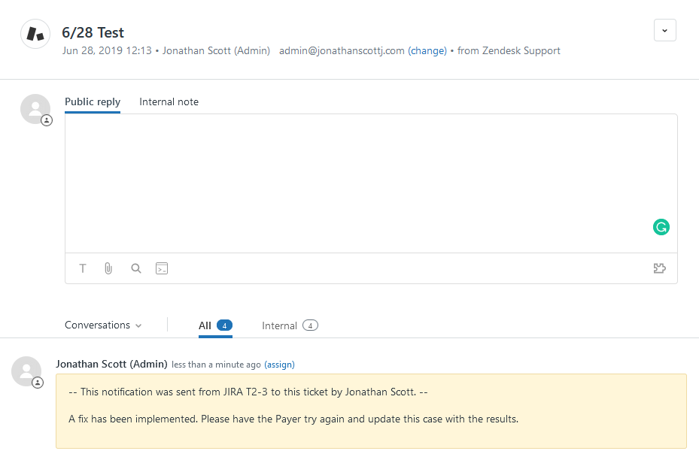
JIRA > Zendesk Integration (Comments)
Updates the Zendesk case with an internal comment when a comment is made in JIRA.
Internal comments in Zendesk automatically set the status to Open
Allows for Agents to know when a JIRA case is updated and what the Engineering team update is.

Slide 19
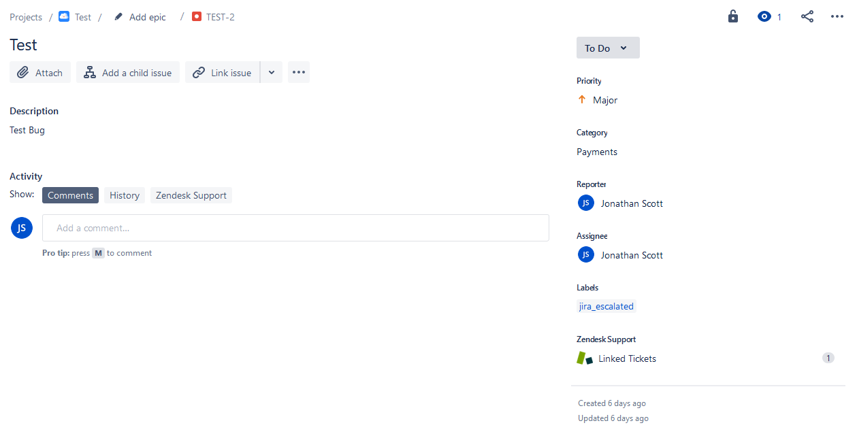
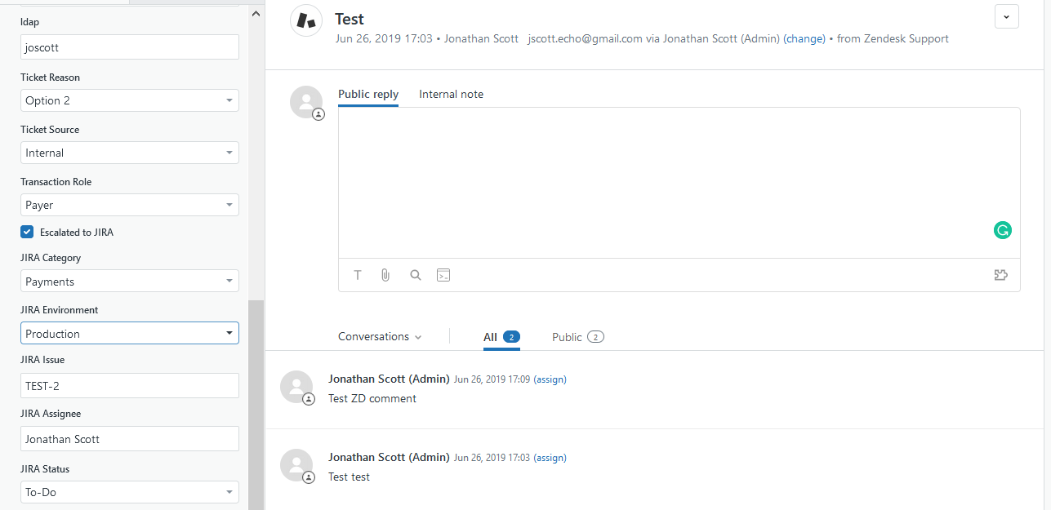
JIRA > Zendesk Integration (Fields)
JIRA updating fields in the Zendesk case
Allows for reporting of what project the JIRA is part of and what the specific data is for the case
Allows for the answering of the following:
What Engineer should I talk to for an update?
What is the Status of the JIRA?
How many Zendesk cases are associated with this JIRA (Reporting)

Slide 20
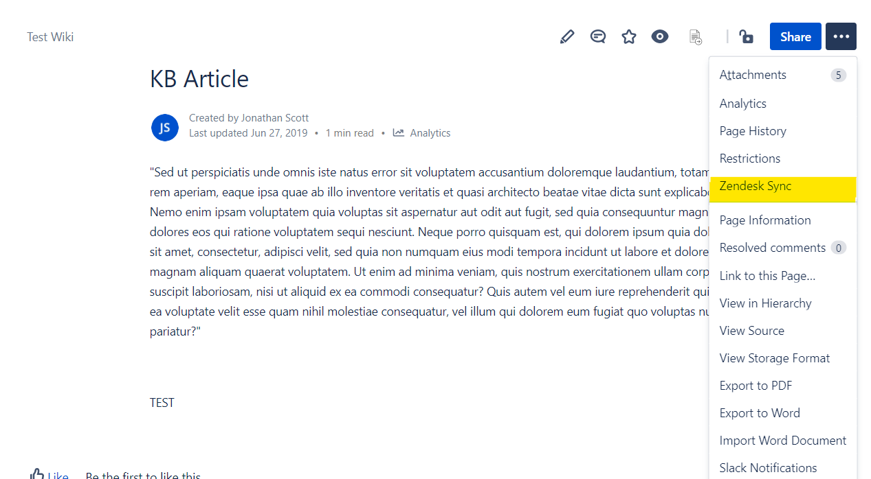
Confluence > Zendesk Integration (Knowledge Sync)
Allows for the Zendesk KB to be updated directly from Confluence
Confluence articles can be written by Support, Product, Engineering, etc.
Articles can be set to “Agent Only” for further review by Support Lead before posting to Public facing

Slide 21
Case Routing
Goals:
Assign cases to Support Agents automatically
Ensure that cases are spread out evenly
Takes Agent schedules/working hours into account
Priority cases are assigned out first

Slide 22
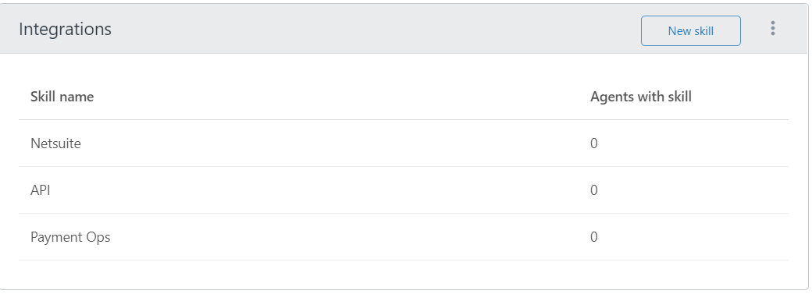
Skill Based Routing
Sets cases with associated skills higher in the queue for Agents who have that skill
Ex- Robert has “NetSuite” skill but Wes does not.
When cases are assigned out; Robert will get the NS case before it gets assigned to Wes.

Slide 23
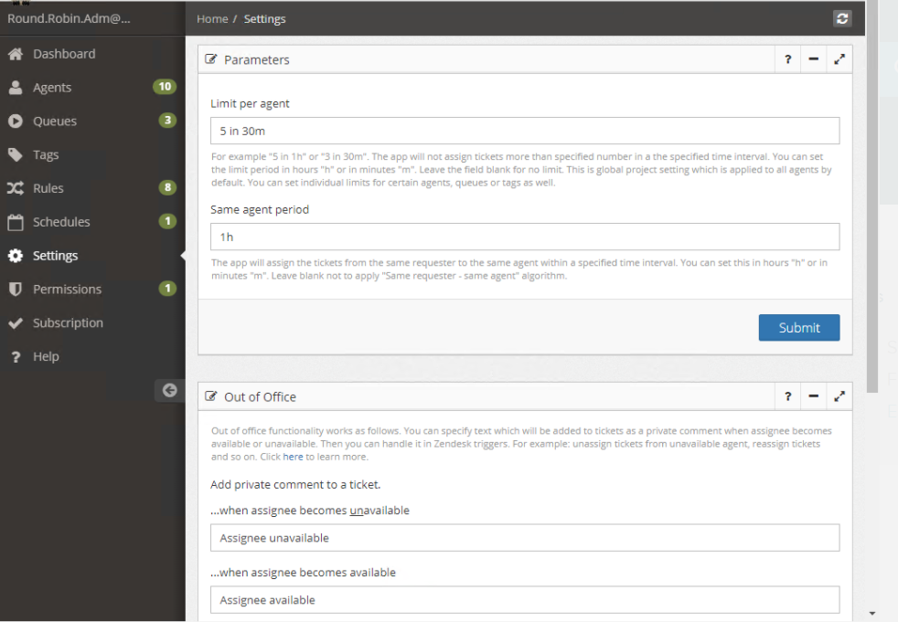
Round Robin Case Assignment
Ability to auto assign cases based on criteria (assign up to X cases per hour / agent)
Priority can be assigned to specific tags/components:
We can set it up so that VIP / Sev I accounts and integrations will be assigned first
$139 per month

